Slide 1
Big Data 02. Introduction to Hadoop and Spark
sisong@ut.ac.kr
한국교통대학교 컴퓨터공학전공
송석일

Slide 2
Technical Stacks for Big Data
Data Storage and Management
HDFS (Hadoop Distributed File System): For storing large datasets in a distributed manner.
Cassandra: A NoSQL database that provides high availability and scalability.
MongoDB: Another NoSQL database used for its flexibility and scalability.
Amazon S3: Cloud-based storage service often used in big data pipelines.
Data Ingestion
Kafka: A real-time, distributed messaging system for big data ingestion.
Flume: Used for aggregating and moving large amounts of log data.
Sqoop: For transferring bulk data between Hadoop and relational databases.
Data Processing
MapReduce: A programming model for parallel computation.
Spark: An in-memory data processing engine, faster than MapReduce.
Flink: A stream-processing framework for real-time analytics.
Hive: A SQL-like query language for batch processing over HDFS.

Slide 3
Technical Stacks for Big Data
Data Analysis and Machine Learning
Mahout: Scalable machine learning library.
MLlib: Machine Learning library in Spark.
TensorFlow, Pytorch: Open-source machine learning framework, which can also be used in big data analytics.
Data Orchestration
Oozie: Workflow scheduler for Hadoop jobs.
Airflow: Workflow automation and scheduling system that can be integrated with various big data technologies.
Luigi: Workflow engine that helps stitch together batch-processing jobs.
MLFlow : An open source platform for the machine learning lifecycle.
Data Visualization and Dashboard
Tableau: For interactive data visualization.
Kibana: Used typically with Elasticsearch for visualizing data in real-time.
Grafana: Open-source platform for monitoring and observability.

Slide 4
Technical Stacks for Big Data
Monitoring and Management
Ambari: For managing and monitoring Hadoop clusters.
Ganglia: A scalable distributed monitoring system.
ZooKeeper: Provides operational services for a Hadoop cluster.
Security
Kerberos: Network authentication protocol.
Sentry: For fine-grained, role-based authorization in Hadoop.

Slide 5
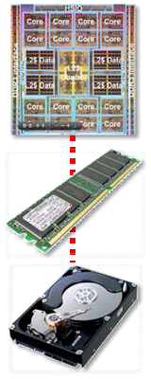
Distributed Processing Technologies for Big Data
Increase CPU Cores
[Example]
Seagate HD with 1TB capacity and 100MB/s bandwidth
Time required to read all 1TB data from a single HD ➔ Approximately within 2 hours
Time required to read 1TB data in parallel from 100 HDs, each storing 1/100th of the data (10GB) ➔ Approximately within 2 minutes
Data Transfer
(CPU-Mem)
Data Transfer
(Disk-Mem)
Is it possible to connect 100 HDs to a single computer?
Even if it is possible to connect, there is only one data bus transferring data to Memory, leading to a bottleneck situation.

Slide 6
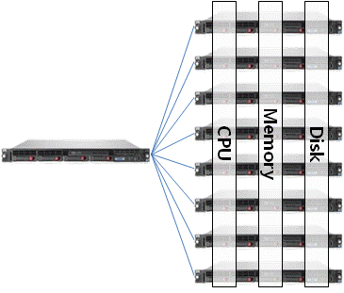
Distributed Processing Technologies for Big Data
[Example]
Seagate HD with 1TB capacity and 100MB/s bandwidth
Time required to read 1TB data in parallel from 100 computers (nodes), each storing 1/100th of the data (10GB): Approximately within 2 minutes
100 data buses, no bottleneck issue
컨트롤러
Master
CPU, Memory, and Disk operating in parallel ➔ approximately 1.8 times performance improvement with the addition of one more unit.
Any other problem?
Continuous Scalability Possible
Horizontal Scalability

Slide 7
Distributed Processing Technologies for Big Data
Is simply increasing the number of computers the solution to all problems?
What about the software development for performing distributed parallel processing?
How is the task distribution between computers managed?
What about data exchange between computers?
What happens if a computer breaks down?

Slide 8
Problems in Existing Distributed Processing Systems with Horizontal Scalability
Platform Dependence: only operate in specific hardware environments or with specific software.
Increased Node Failure Probability: The more nodes there are in the system, the higher the likelihood of node failure.
Expensive Hardware for Resilience: Traditionally, expensive hardware was used in distributed systems to mitigate the impact of equipment failures.
Need for Generic and Easily Accessible Software: The system should be able to utilize general-purpose hardware and easily accessible software.
Data Distribution and Result Aggregation Issues
Distributed systems must deal with the challenges of distributing data across nodes and then aggregating the processed results.
Developers of distributed applications need to break down one job into multiple tasks and decide which node will execute each task.
Task Aggregation and Failure Handling
how to aggregate the results of each task
what to do in case a node failure causes task processing to fail

Slide 9
Introduciton to Hadoop

Slide 10
Introduction to Hadoop
Solutions for Overcoming Problems in Distributed Processing Systems with Horizontal Scalability
Operates not just on expensive hardware but also on generic hardware.
Fault Tolerance: designed such that if some nodes fail, there is no data loss or task processing failure ➔ general-purpose hardware
Data Redundancy: To mitigate against node failure, data is duplicated across multiple nodes.
Provides a large-scale data storage solution by virtualizing the storage of each node into a unified data store.
Offers a programming model to facilitate parallel processing and the merging of results.

Slide 11
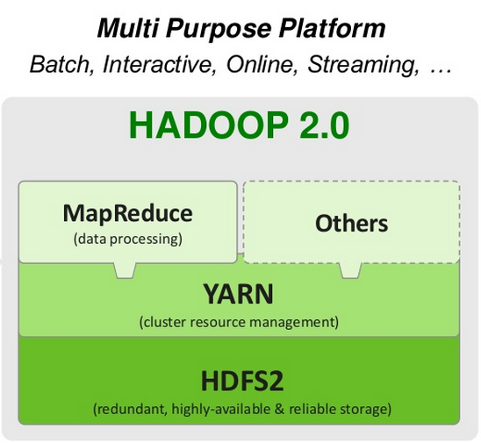
Introduction to Hadoop
Components of Hadoop
Hadoop distributed file system (HDFS)
Structured to store large volumes of data across multiple nodes.
Combines multiple nodes to provide users with a single, large file system.
Yet Another Resource Negotiator (YARN)
Cluster resource management
decouples the programming model from the resource management layer to offer more flexibility
Parallel Distributed Processing Framework (MapReduce)
Divides one large job into multiple smaller tasks for parallel processing.

Slide 12
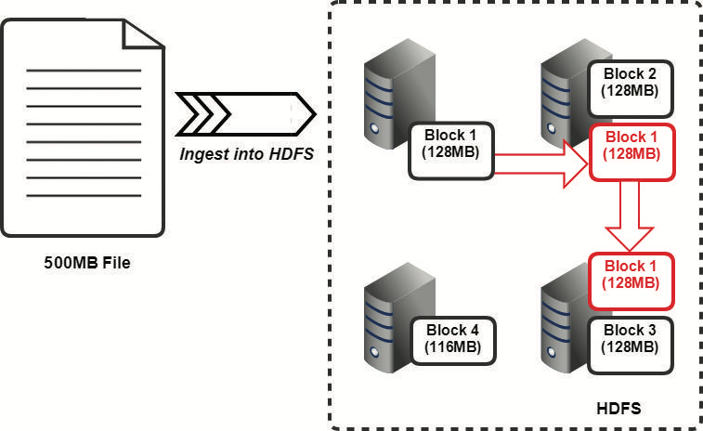
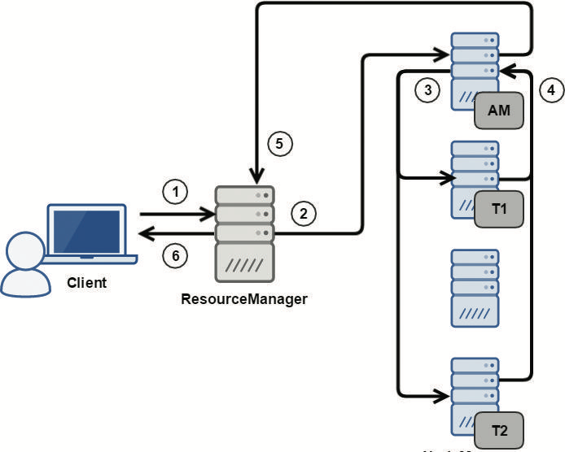
Introduction to Hadoop
HDFS
YARN

Slide 13
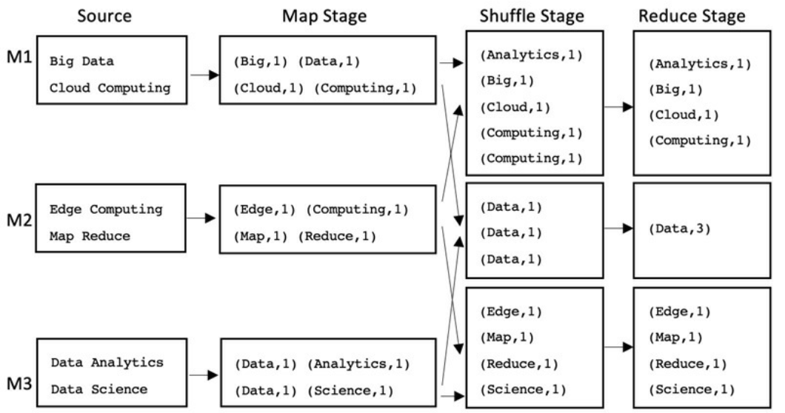
Introduction to Hadoop
MapReduce (Word Count Example)

Slide 14
Introduction to Apache Spark

Slide 15
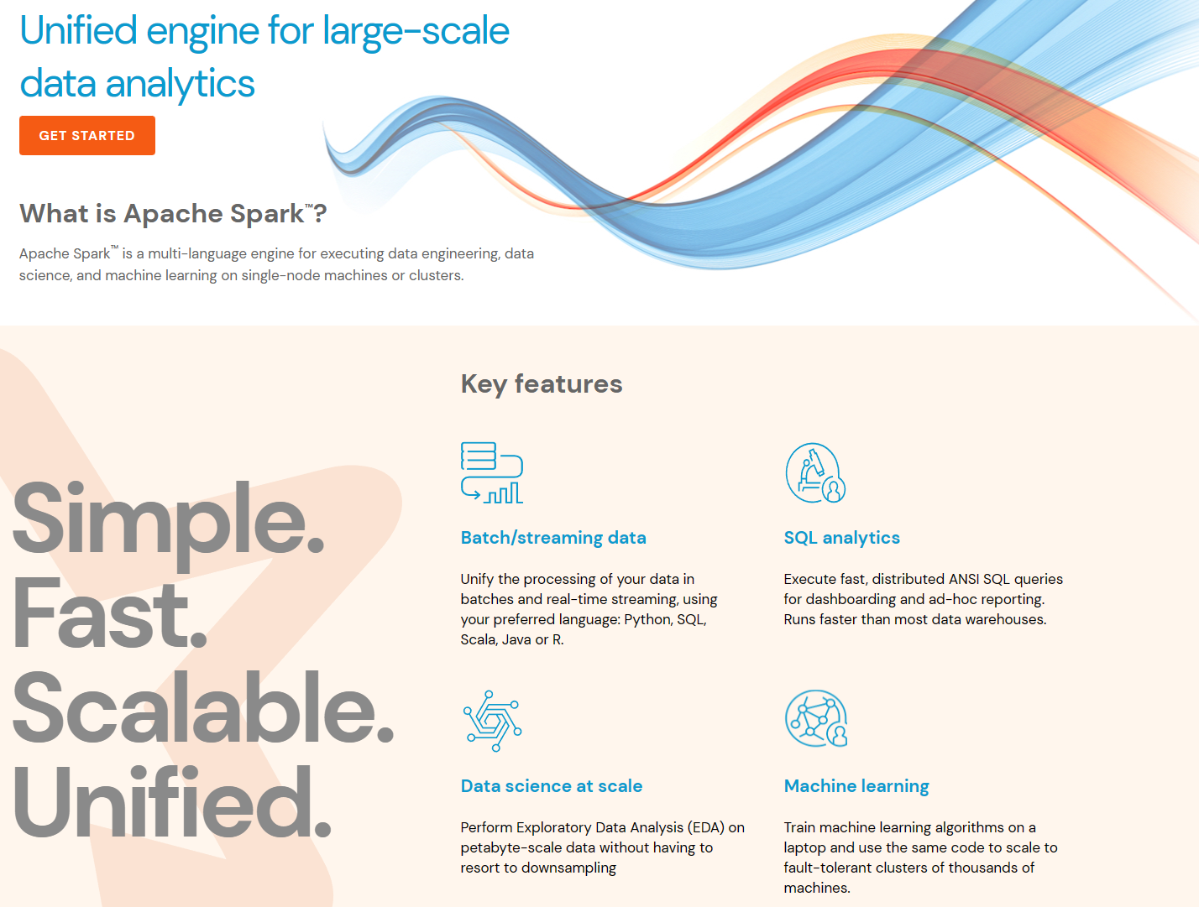
Apache Spark ?

Slide 16
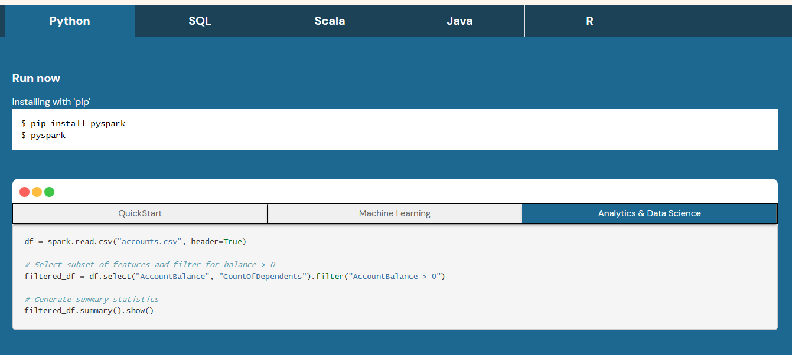

Slide 17
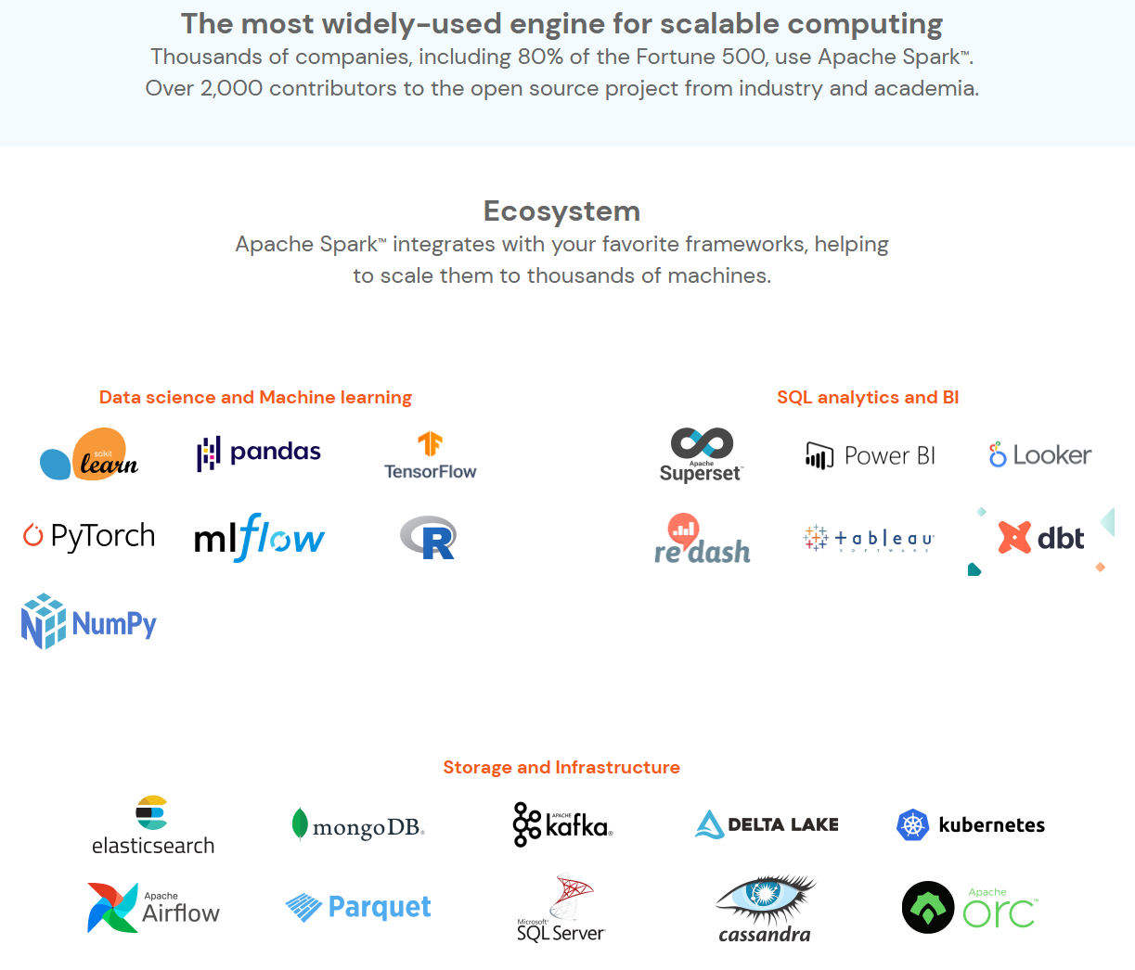

Slide 18
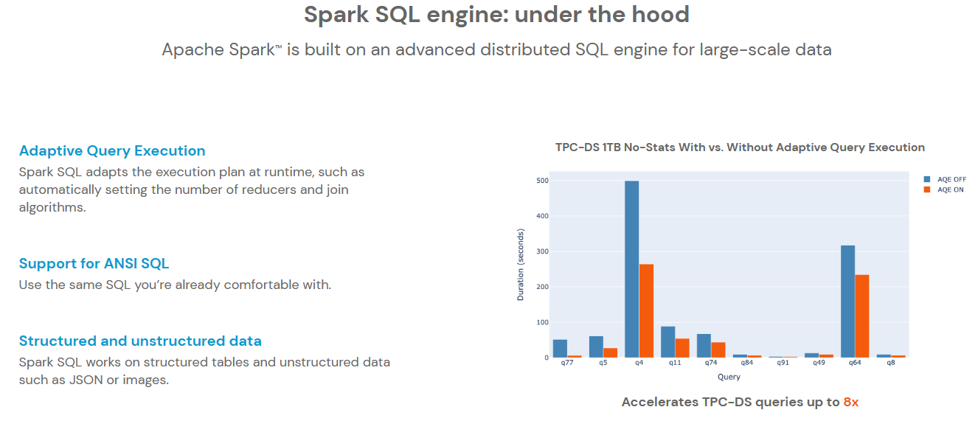

Slide 19
Apache Spark ?
In-Memory Large-Scale Data Processing Engine
Implements performance up to 100 times faster than Hadoop's MapReduce.
General-Purpose Distributed Cluster Computing Framework
Easy to use (??)
Multi-Language Support
Supports application development in JAVA, Python, Scala, R, and SQL.
Apache Top Project
Started as an open-source project at UC Berkeley's AMPLab in 2009.
Became an Apache project in 2013.
Elevated to an Apache top-level project in 2014.
Current Stable Releases
Spark 3.4.0 (Released on April 13, 2023)
Spark 3.3.2 (Released on February 17, 2023)
Spark 3.2.4 (Released on April 13, 2023)

Slide 20
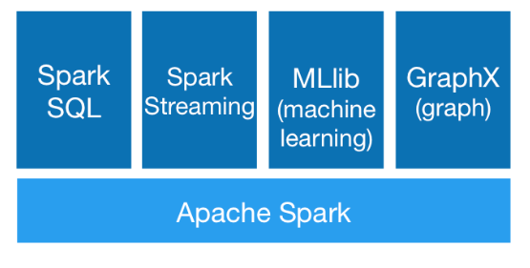
Apache Spark ?
Runs Everywhere
Operable not only in Standalone but also through various cluster resource management packages like YARN and Mesos.
Supports cluster mode on EC2, Hadoop YARN, Mesos, or Kubernetes.
Can access data in HDFS, Alluxio, Apache Cassandra, Apache HBase, Apache Hive, etc.
Generality
Scalability
More than 8,000 nodes scalability

Slide 21
Spark Architecture
Supports Multiple Environments for Distributed Cluster Computing Setup
Provides its own standalone scheduler for single-node setup.
Integrates with cluster management packages like YARN and Mesos for cluster resource management and environment setup.
Spark Core
Functions as the main component, performing data processing tasks by applying operations on batch-based RDDs (Resilient Distributed Datasets).
Officially Supported Additional Libraries
Built on Spark Core, it supports SQL analytics, streaming processing, machine learning, and graph processing.

Slide 22
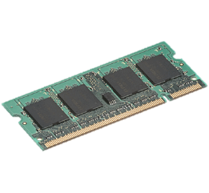
MapReduce 의 단점
HDFS read
HDFS write
HDFS read
HDFS write
Input
iter. 1
iter. 2
. . .
Stores intermediate results on disk (3 replicas).
Necessary to ensure fault tolerance.
Input
iter. 1
iter. 2
. . .
What if intermediate results could be stored in memory while ensuring fault tolerance?
Notes:
Each iteration is, for example, a MapReduce job

Slide 23

MapReduce 의 단점
HDFS read
map1
result 1
map2
result 2
map3
result 3
Input
. . .
map 1
one-time processing
map 2
입력
map 3
Distributed memory
. . .
The issue of reading the input from the beginning during task processing is eliminated.
=> Efficiency in data processing for the same dataset is increased.

Slide 24
RDD (Resilient Distributed Datasets)
Resilient Distributed Dataset (RDD)
Implies the capabilities for distributed processing and fault recovery.
In Spark, all data processed internally is handled as RDD types.
Spark application development starts with an understanding of the following three aspects:
RDD
RDD Transformation API (Scala / Python / Java / R interface)
Libraries for SQL, ML, graph, and streaming built on the RDD Transformation API (Scala / Python / Java / R interface)

Slide 25
RDD (Resilient Distributed Datasets)
Immutable, Partitioned Collections of Records
Immutable: Once an RDD is created, it cannot be modified.
Partitioned: The RDD is partitioned and distributed across multiple nodes for processing.
Operational Processing Methods for RDD
Processing is done in a coarse-grained manner, not fine-grained.
Operations are not applied to individual records within the RDD but are applied to the entire collection.
Lineage
The history of how a particular RDD was created.
In case of machine failure or errors, the lineage can be retraced to regenerate the RDD.

Slide 26
RDD Operations
Transformations ( a new RDD) | map filter sample groupByKey reduceByKey sortByKey | flatMap union join cogroup cross mapValues
Actions (return a result to driver program) | collect reduce count save lookupKey

Slide 27
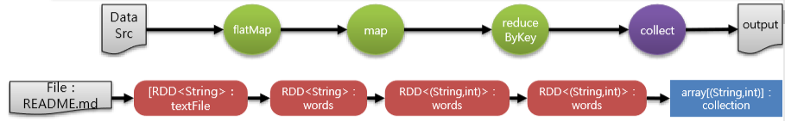
Spark Word Counting Example
scala> textFile = sc.textFile("README.md")
scala> words = textFile.flatMap(line => line.split(" ")) //(transformation)
scala> mapWords = words.map(word => (word, 1)). //(transformation)
scala> redWords = mapWords.reduceByKey((a, b) => a + b) //(transformation)
scala> collection = redWords.Collect() //(action)
Apache Spark
Spark is a fast and general…
high-level APIs in Scala, Java…
supports general computation…
rich set of higher-level tools,…
MLlib for machine learning, …
and Spark Streaming for….
Apache
Spark
Spark
is
a
fast
and
…
(Apache ,1)
(Spark ,1)
(,1)
(Spark ,1)
(is ,1)
(a ,1)
(fast ,1)
(and ,1)
…
(Apache ,24)
(Spark ,16)
(,68)
(help ,1)
(storage ,1)
(Hadoop ,3)
…
(Apache ,24)
(Spark ,16)
(,68)
(help ,1)
(storage ,1)
(Hadoop ,3)
…

Slide 28
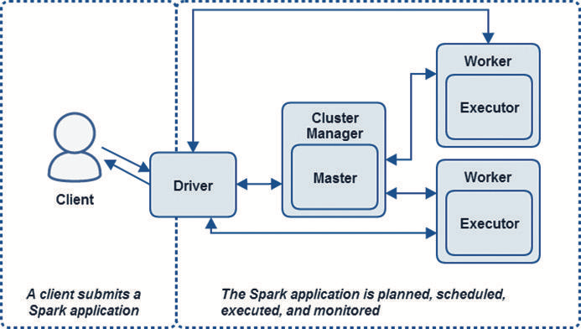
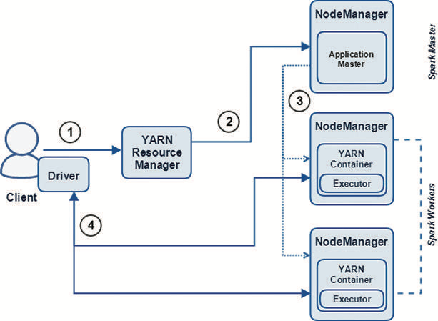
Architecture (Standalone vs. Yarn)

Slide 29
Architecture (Standalone vs. Yarn)

Slide 30
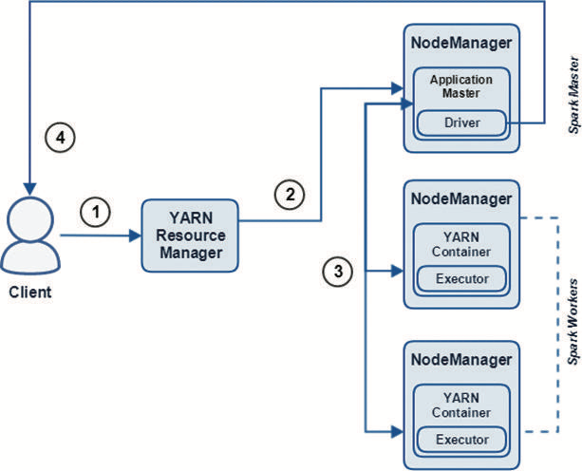
Architecture (Standalone vs. Yarn)

